Slide 1
B.Tech. Project
Data Driven Modelling of Composites
End Term Evaluation
Advisor -
Dr. Siladitya Pal
Aman Shrivastava - 13117008
Mihir Ujjwal Rana - 13117044
Yash Sharma - 13117079

Slide 2
Introduction
Composites -
A composite is a material made from two or more constituent materials with significantly different physical or chemical properties that, when combined, produce a
material with characteristics different from the individual components. The individual components remain separate and distinct within the finished structure. The new material may be preferred for many reasons, primarily to maximize the useful properties and minimize the weaknesses of constituent materials; common examples include materials which are stronger, lighter, or less expensive when compared to traditional materials.

Slide 3

Applications
Airbus A380
More than 20 % of the A380 is made of composite materials, mainly plastic reinforced with carbon fibres. The design is the first large-scale use of glass-fibre-reinforced aluminium, a new composite that is 25 % stronger than conventional airframe aluminium but 20 % lighter.

Slide 4

Applications
Automobiles
Composites are being used increasingly in the automotive industry due to their
strength, quality and light-weight. The materials used in automotive engineering play key roles in making lighter vehicles and ultimately lower emissions.

Slide 5
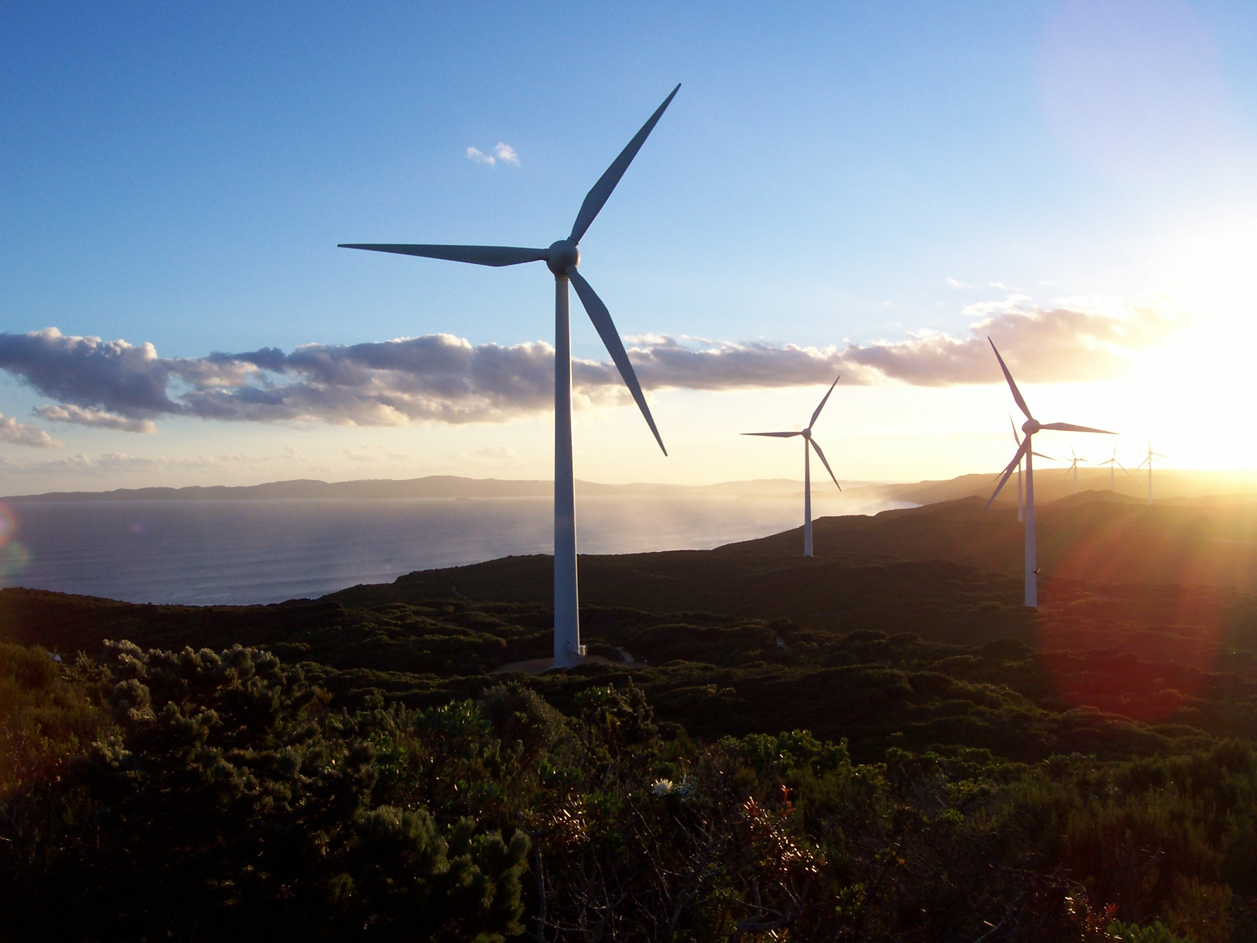
Applications
Wind Turbine
Currently, carbon fiber is used primarily in the spar, or structural element, of wind blades longer than 45m/148 ft, both for land-based and offshore systems. The higher stiffness and lower density of CF allows a thinner blade profile while producing stiffer, lighter blades.

Slide 6
Challenges
Since precise material properties are often needed to satisfy industrial needs and criteria, design of composites with tailored properties is of utmost importance.
The design and analysis of such composites faces following challenges -
Computational Expense
Heavy Simulations
Rigorous Experimentation
Time Expensive Process

Slide 7
Project Objective
To develop an algorithmic framework to predict properties of composites to aid in meta-modelling process.

Slide 8
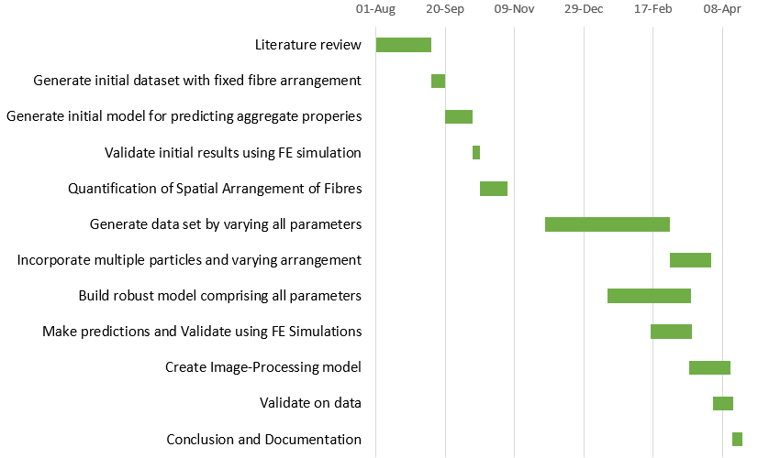
Project Timeline

Slide 9
General Workflow
Random Sequential Adsorption
FEM
Master Data
Images
Image Data Extraction
Trained Model
Machine Learning
Preprocessed Data
Predictions
Validation

Slide 10
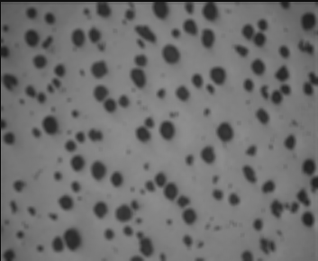
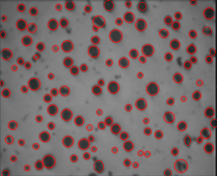
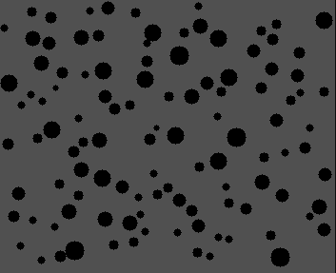
Image Data Extraction

Slide 11
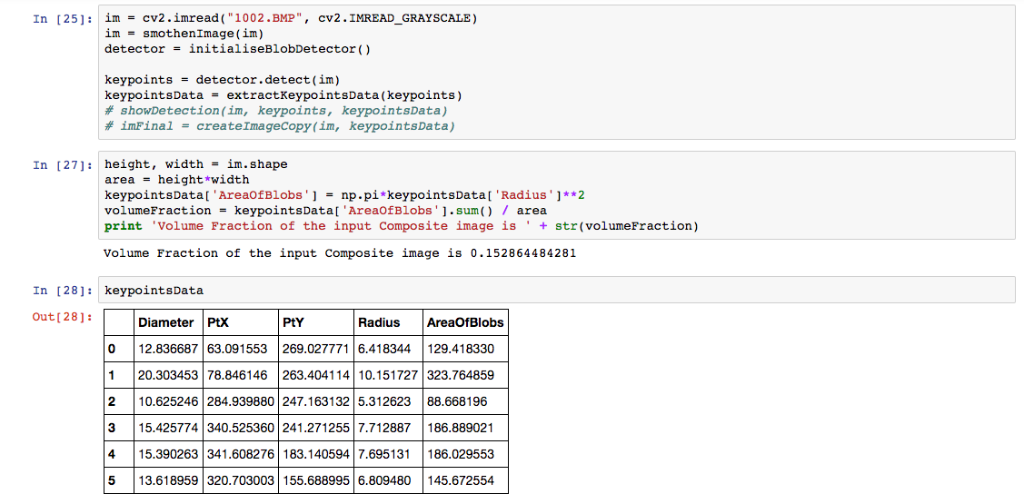
Image Data Extraction

Slide 12
Data for Constructing Stress-Strain Curve
The first data set is created for building the stress-strain curves for various composites.
For this, the following features are considered:
Youngs Moduli of matrix and fibre
Poisson’s Ratios of matrix and fibre
Strain (normally distributed; 10 values considered)
Volume fraction (5%-30%, in increments of 5%)
Characteristics of data:
Total size (rows) of data = 60,000
Number of unique materials = 100

Slide 13
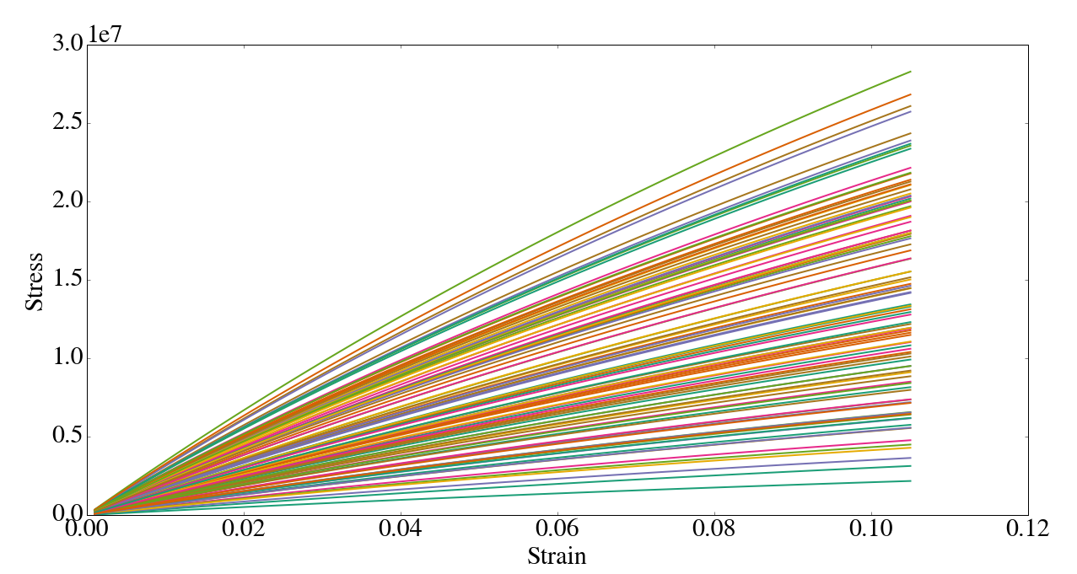
Range of Data Considered

Slide 14
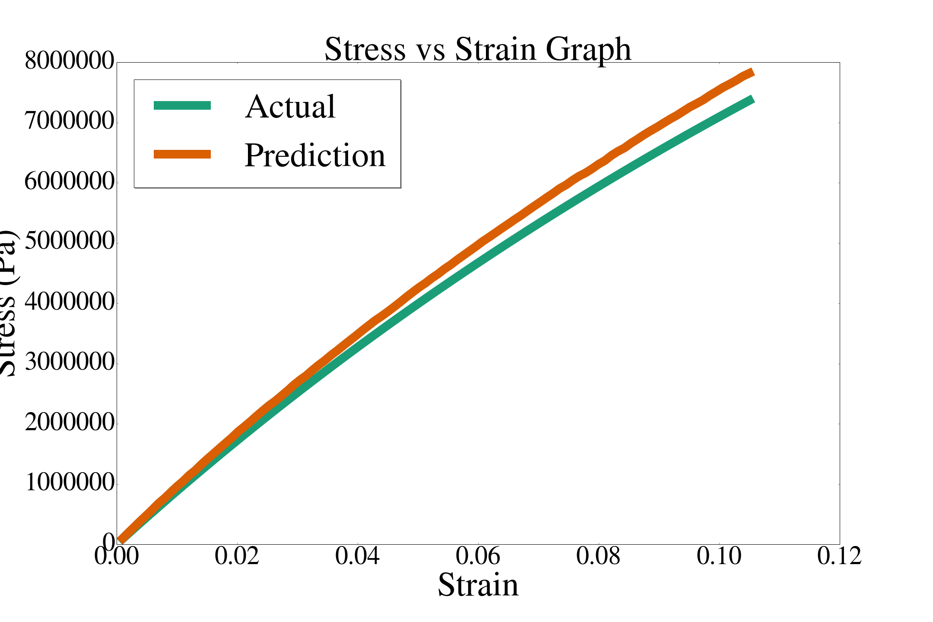
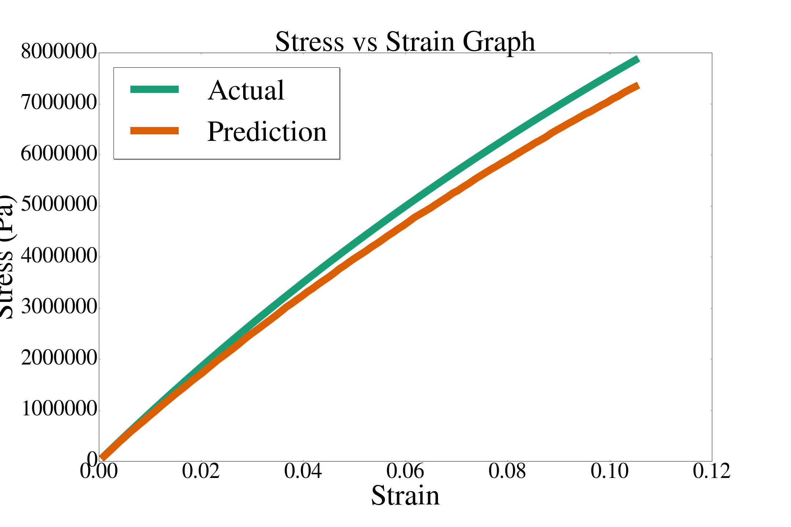
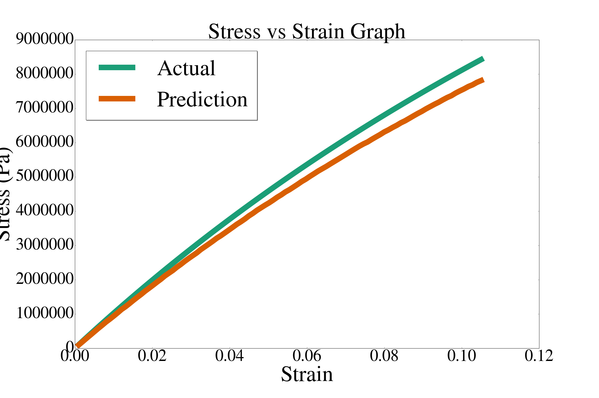
Results: Stress-Strain Curves at Different Volume Fractions
VF = 5%
VF = 10%
VF = 15%
R²=0.99
R²=0.97
R²=0.96
VF: 5%
VF:10%
VF:15%

Slide 15
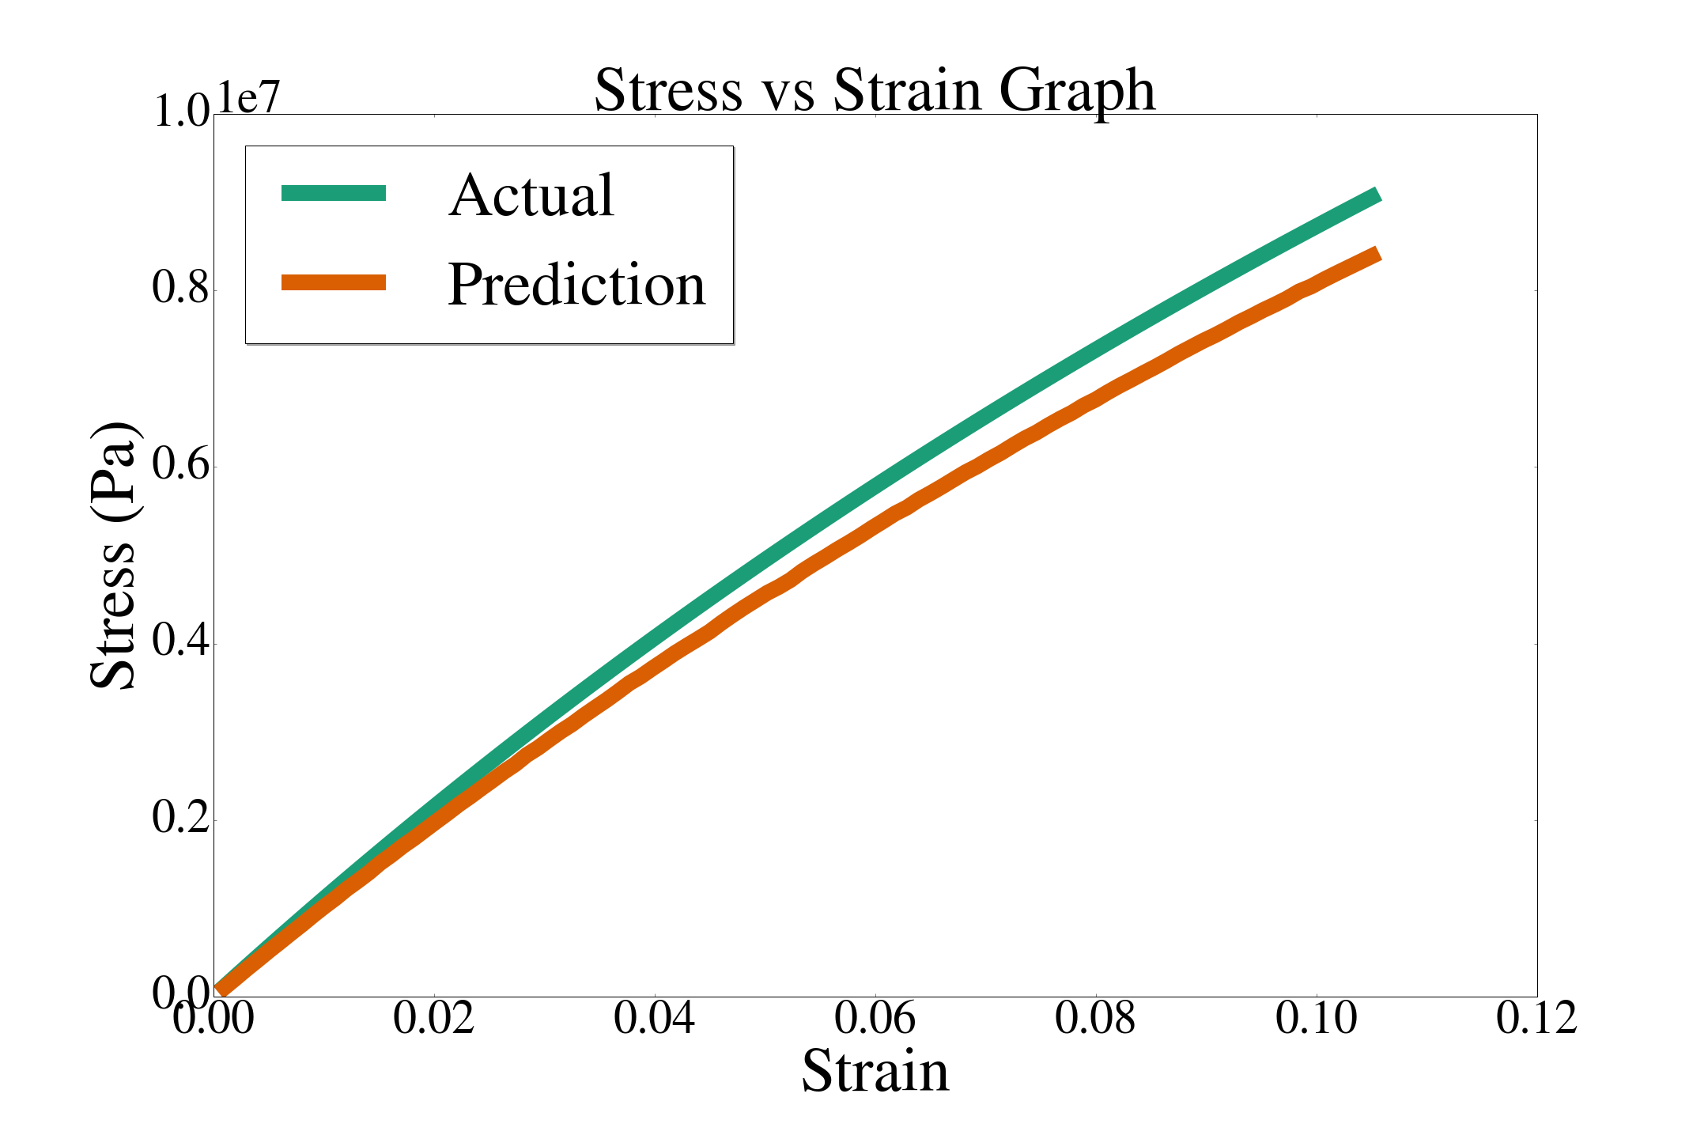
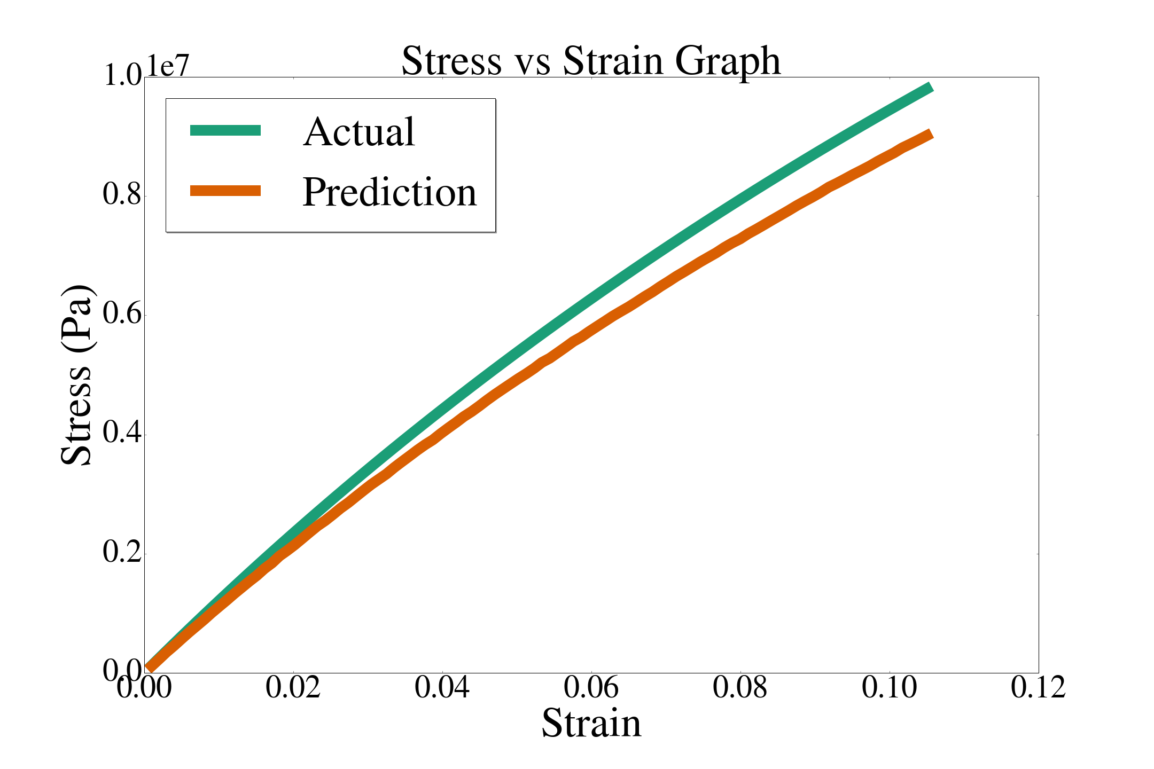
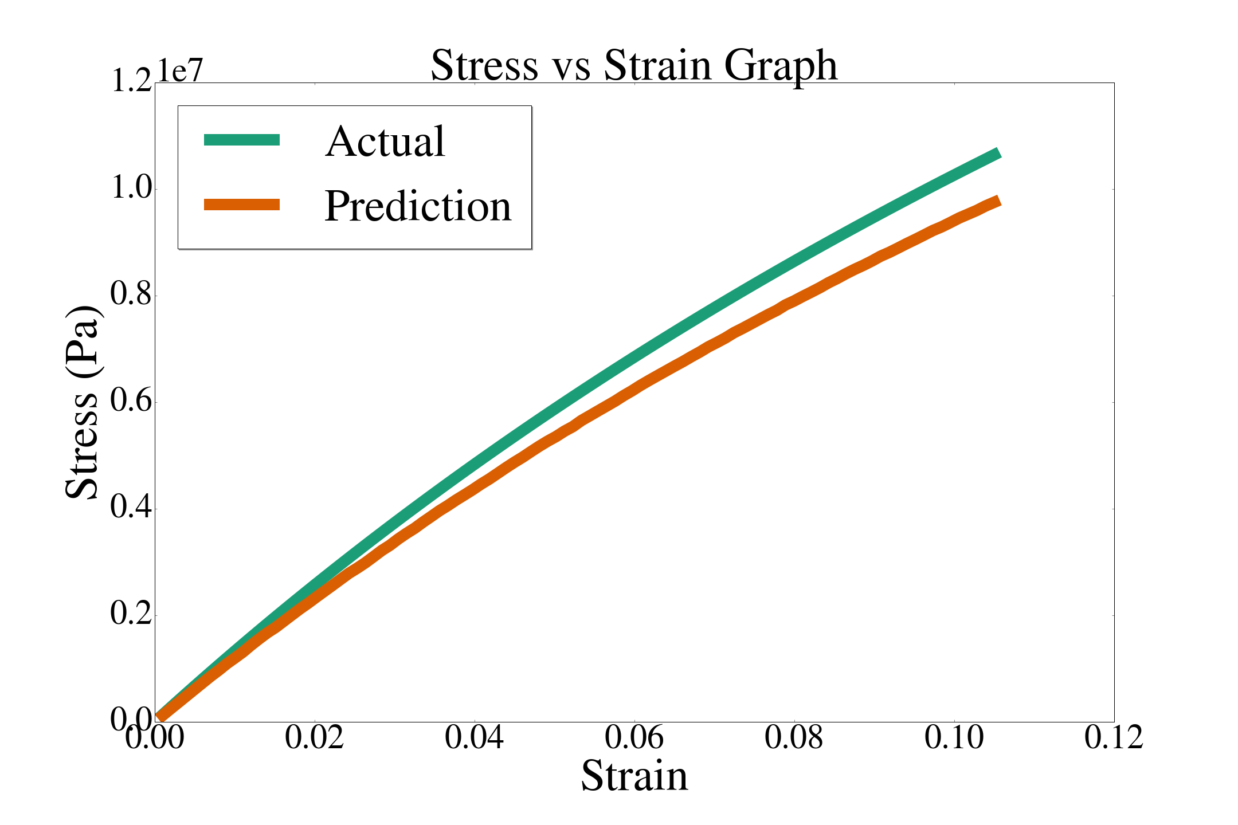
Results: Stress-Strain Curves at Different Volume Fractions
VF = 20%
VF = 25%
VF = 30%
R²=0.95
R²=0.96
R²=0.95
VF:20%
VF:25%
VF:30%

Slide 16
Random Sequential Adsorption Model
To generate a statistically equivalent RVE, the Random Sequential Adsorption model was used. This method creates a set of randomly distributed distributed points inside a square region, with the constraint that no pair of points may be closer points inside a square region and no closer than a certain minimum distance.
Steps:
Setting the values of volume fraction
Limit the distance between fibres (circles) and between circles and the walls of the unit cell
Required diameter of circles and their number is determined
Required arrangement is obtained in a random manner to ensure isotropic nature

Slide 17
Finite Element Method
Steps
Generate 5 microstructures for each composite for each volume fraction
Volume fraction = {0.3, 0.4, 0.5}
Plane strain (ϵ₁₁, ϵ₂₂, ϵ₁₂)
Composite range shown on the following slide
Obtain the average stress values
When L/d > 20, the difference observed due to spatial arrangement of particles is not significant
L = Length of unit cell, d = diameter of particles
Obtain tangent moduli (formulae shown later)
Feed tangent moduli data to ML model

Slide 18
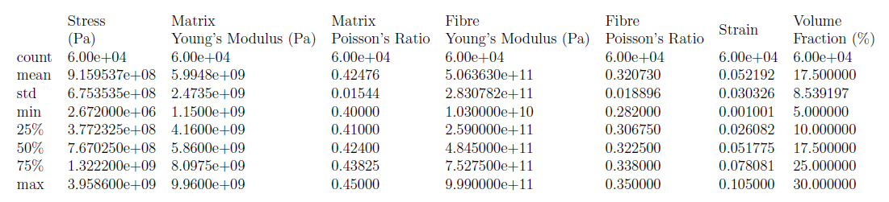
Description of Generated Data

Slide 19
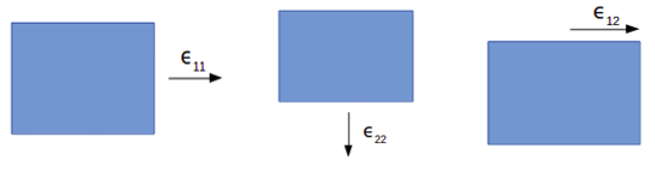
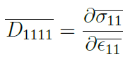
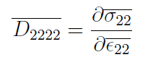
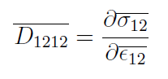
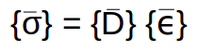
Tangent Moduli Formulae

Slide 20
Machine Learning
Training
Features:
Young’s Modulus of Matrix (E_{m}) and Fibre (E_{f})
Poisson’s Ratio of Matrix (ν_{m}) and Fibre (ν_{f})
Volume Fraction (Φ) - obtained from image or set to {0.3, 0.4, 0.5} during generation from FEM
Tangent Moduli (FEM)
Target:
Tangent Moduli (D₁₁₁₁, D₂₂₂₂, D₁₂₁₂)

Slide 21
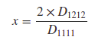
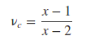
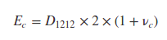
Machine Learning
Algorithms:
XGBoost Regressor (XGB)
Random Forest Regressor (RF)
Ensemble of XGB and RF
After obtaining the tangent moduli, apply relevant formulae (given on next page) to get:
Young’s Modulus of composite (E_{m})
Shear Modulus of composite (D₁₂₁₂)
Poisson’s ratio of composite (ν_{c})

Slide 22
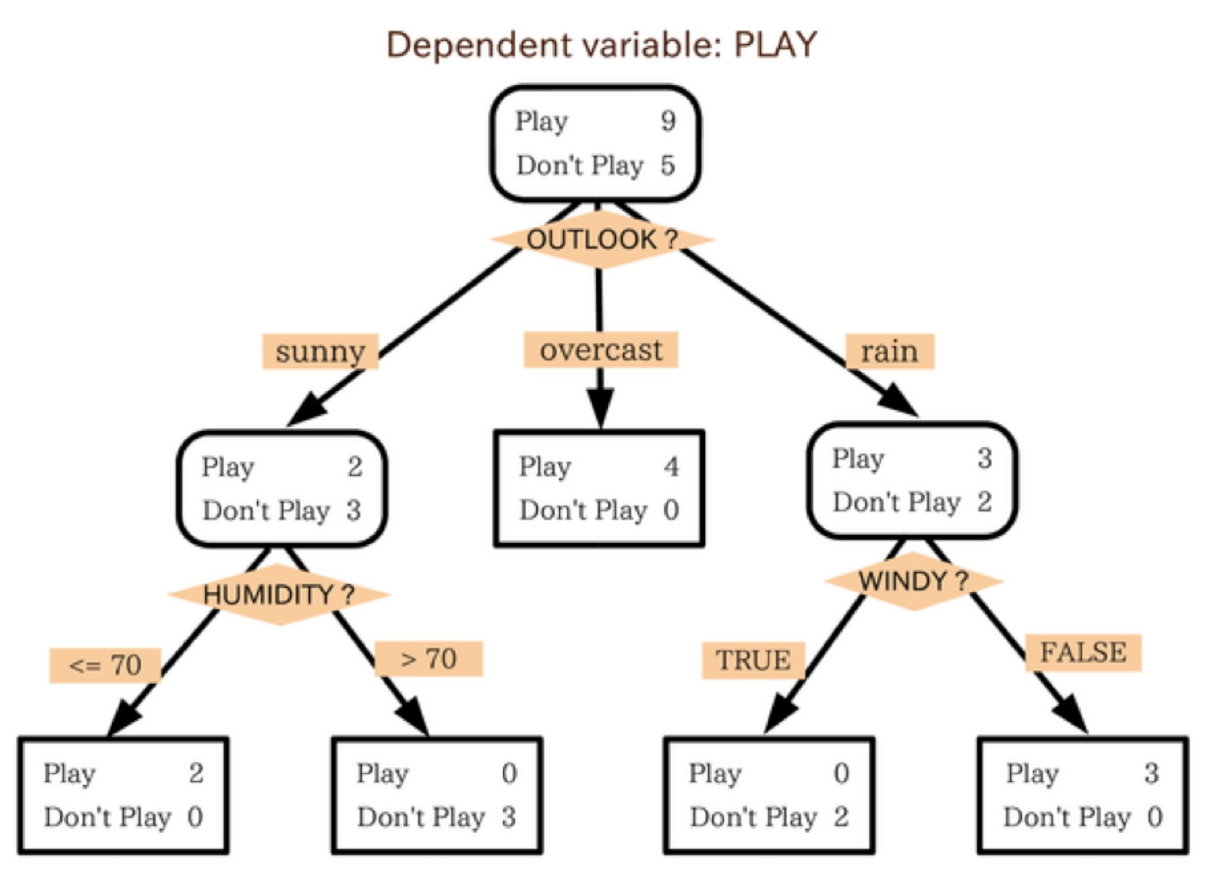
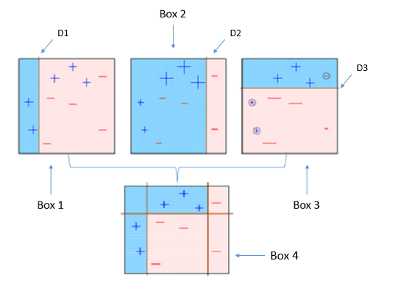
Machine Learning Algorithms
Decision Tree
Decision Tree Algorithm
(Graphically)

Slide 23
Procedure
We considered two composites with properties in our predictable range.
Glass (Fibre) - Epoxy (Matrix)
E_{f} = 71 GPa
ν_{f} = 0.22
E_{m} = 4 GPa
ν_{m} = 0.35
Boron (Fibre) - Epoxy (Matrix)
E_{f} = 420 GPa
ν_{f} = 0.2
E_{m} = 4 GPa
ν_{m} = 0.35

Slide 24
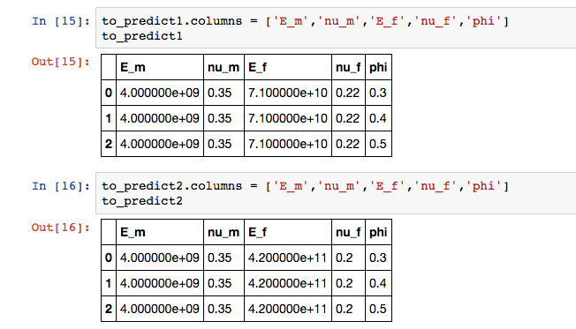
Procedure
Made predictions on 3 different volume fractions
Volume Fractions (Φ) = 0.3, 0.4, 0.5
Inputs - E_{m}, ν_{m}, E_{f} , ν_{f} , Φ

Slide 25
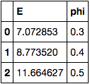
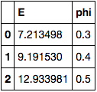
Procedure
Predictions
Glass-Epoxy
Boron-Epoxy

Slide 26
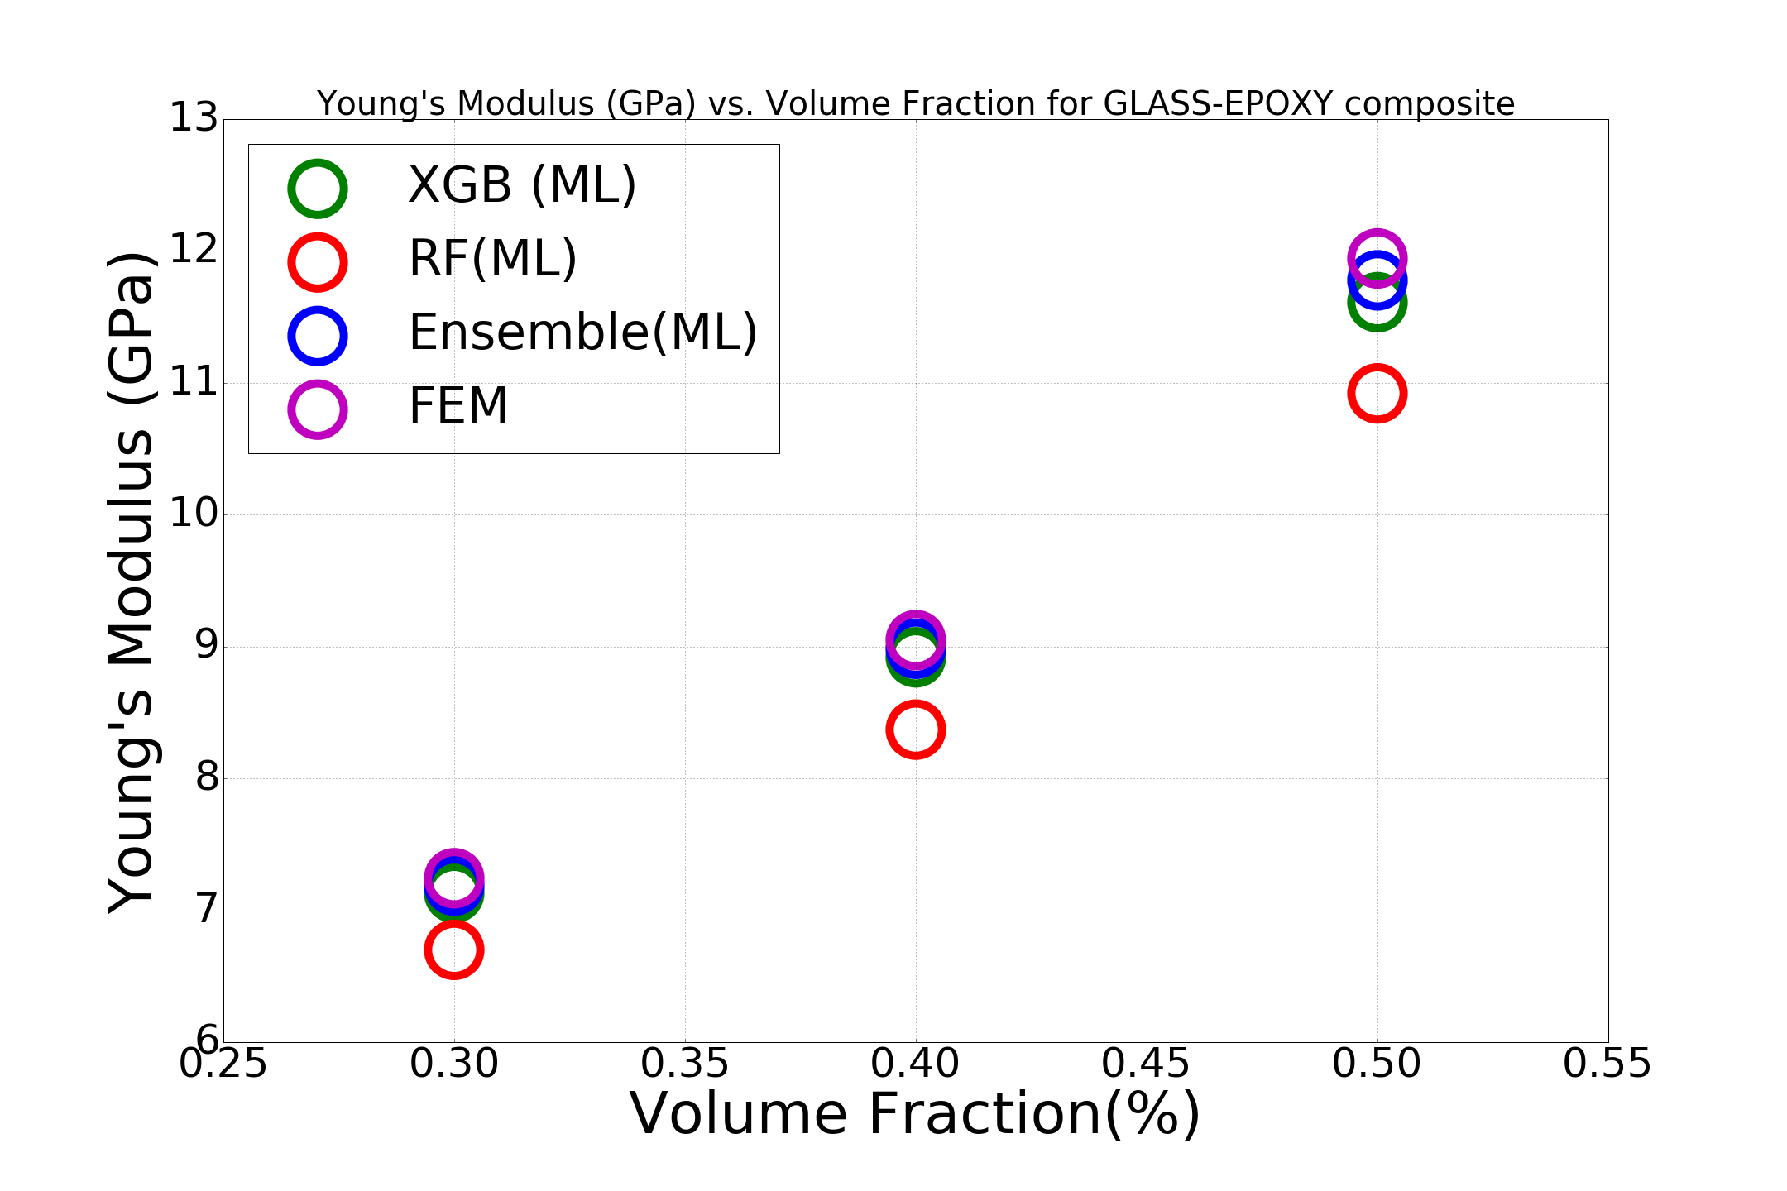
Accuracy Comparison (Young’s Modulus)

Slide 27
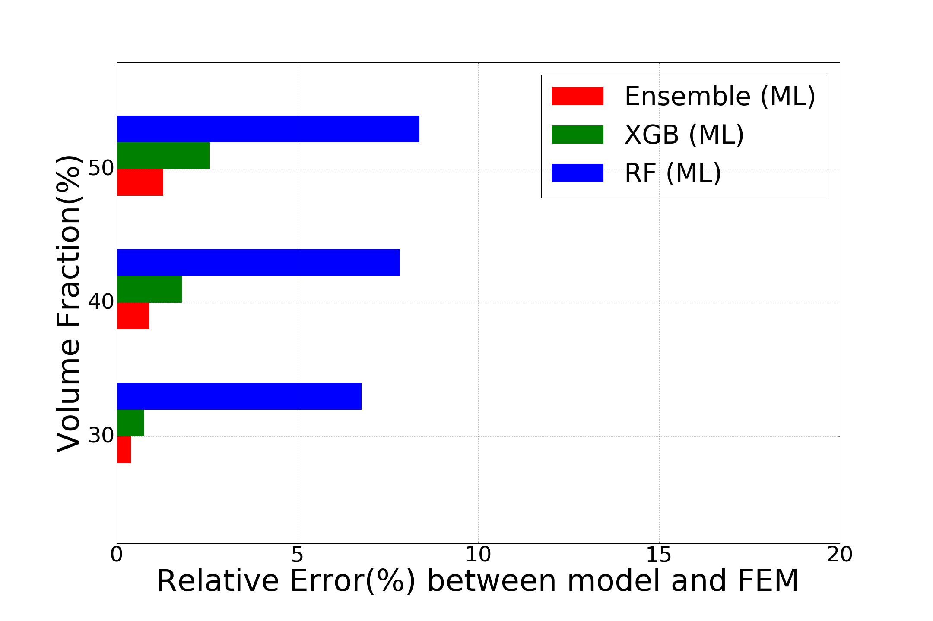
Percentage Error - Glass Epoxy (Young’s Modulus)

Slide 28
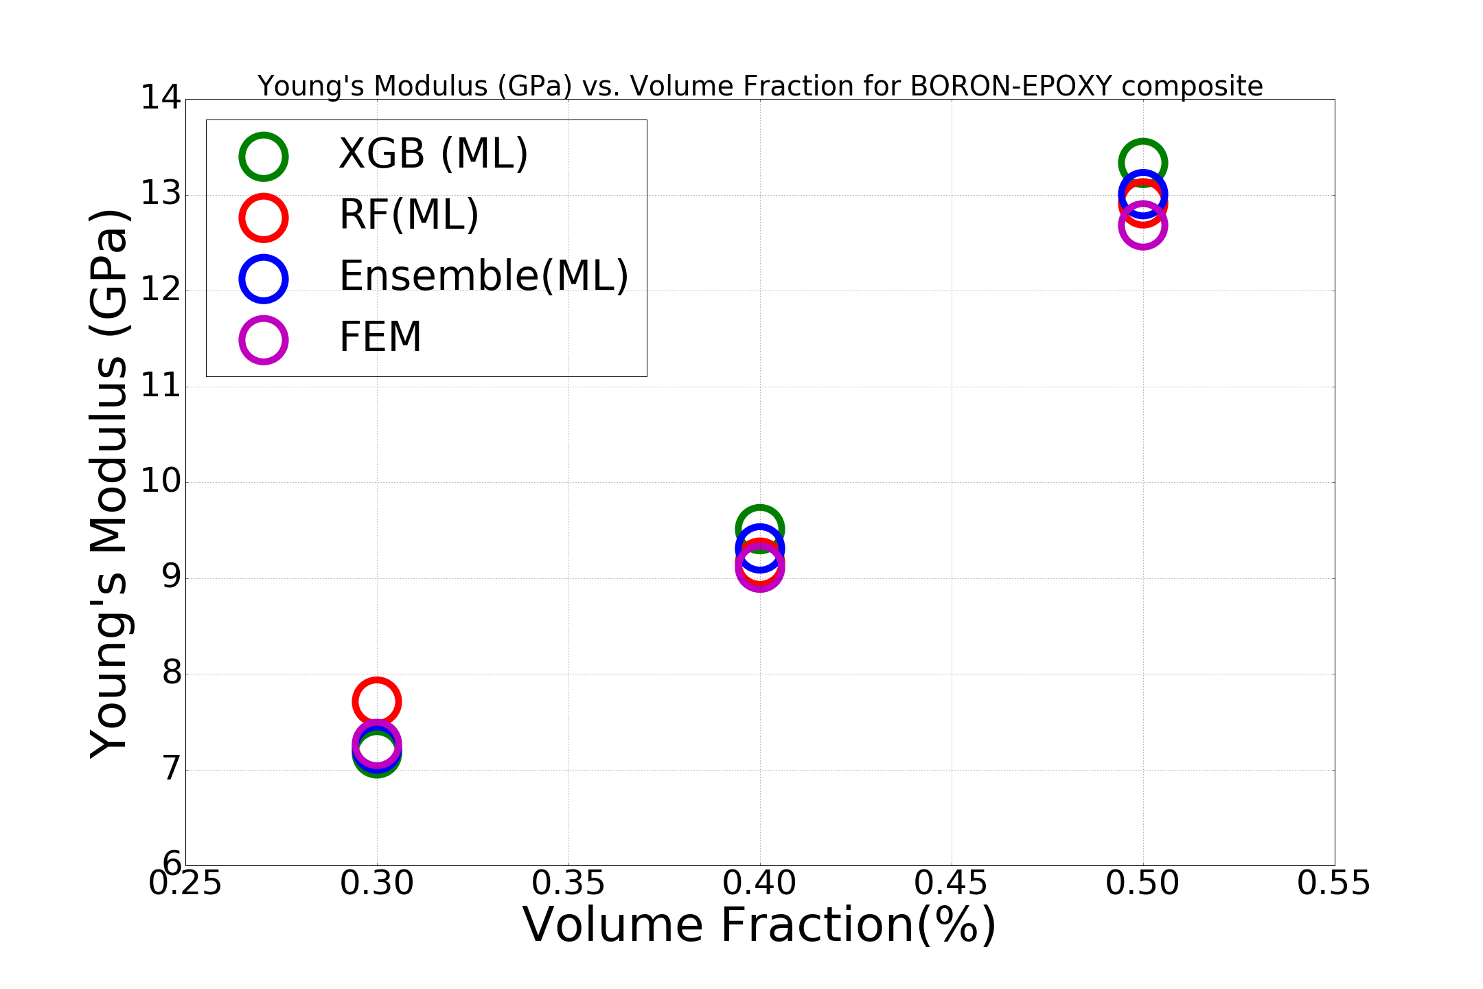
Accuracy Comparison (Young’s Modulus)

Slide 29
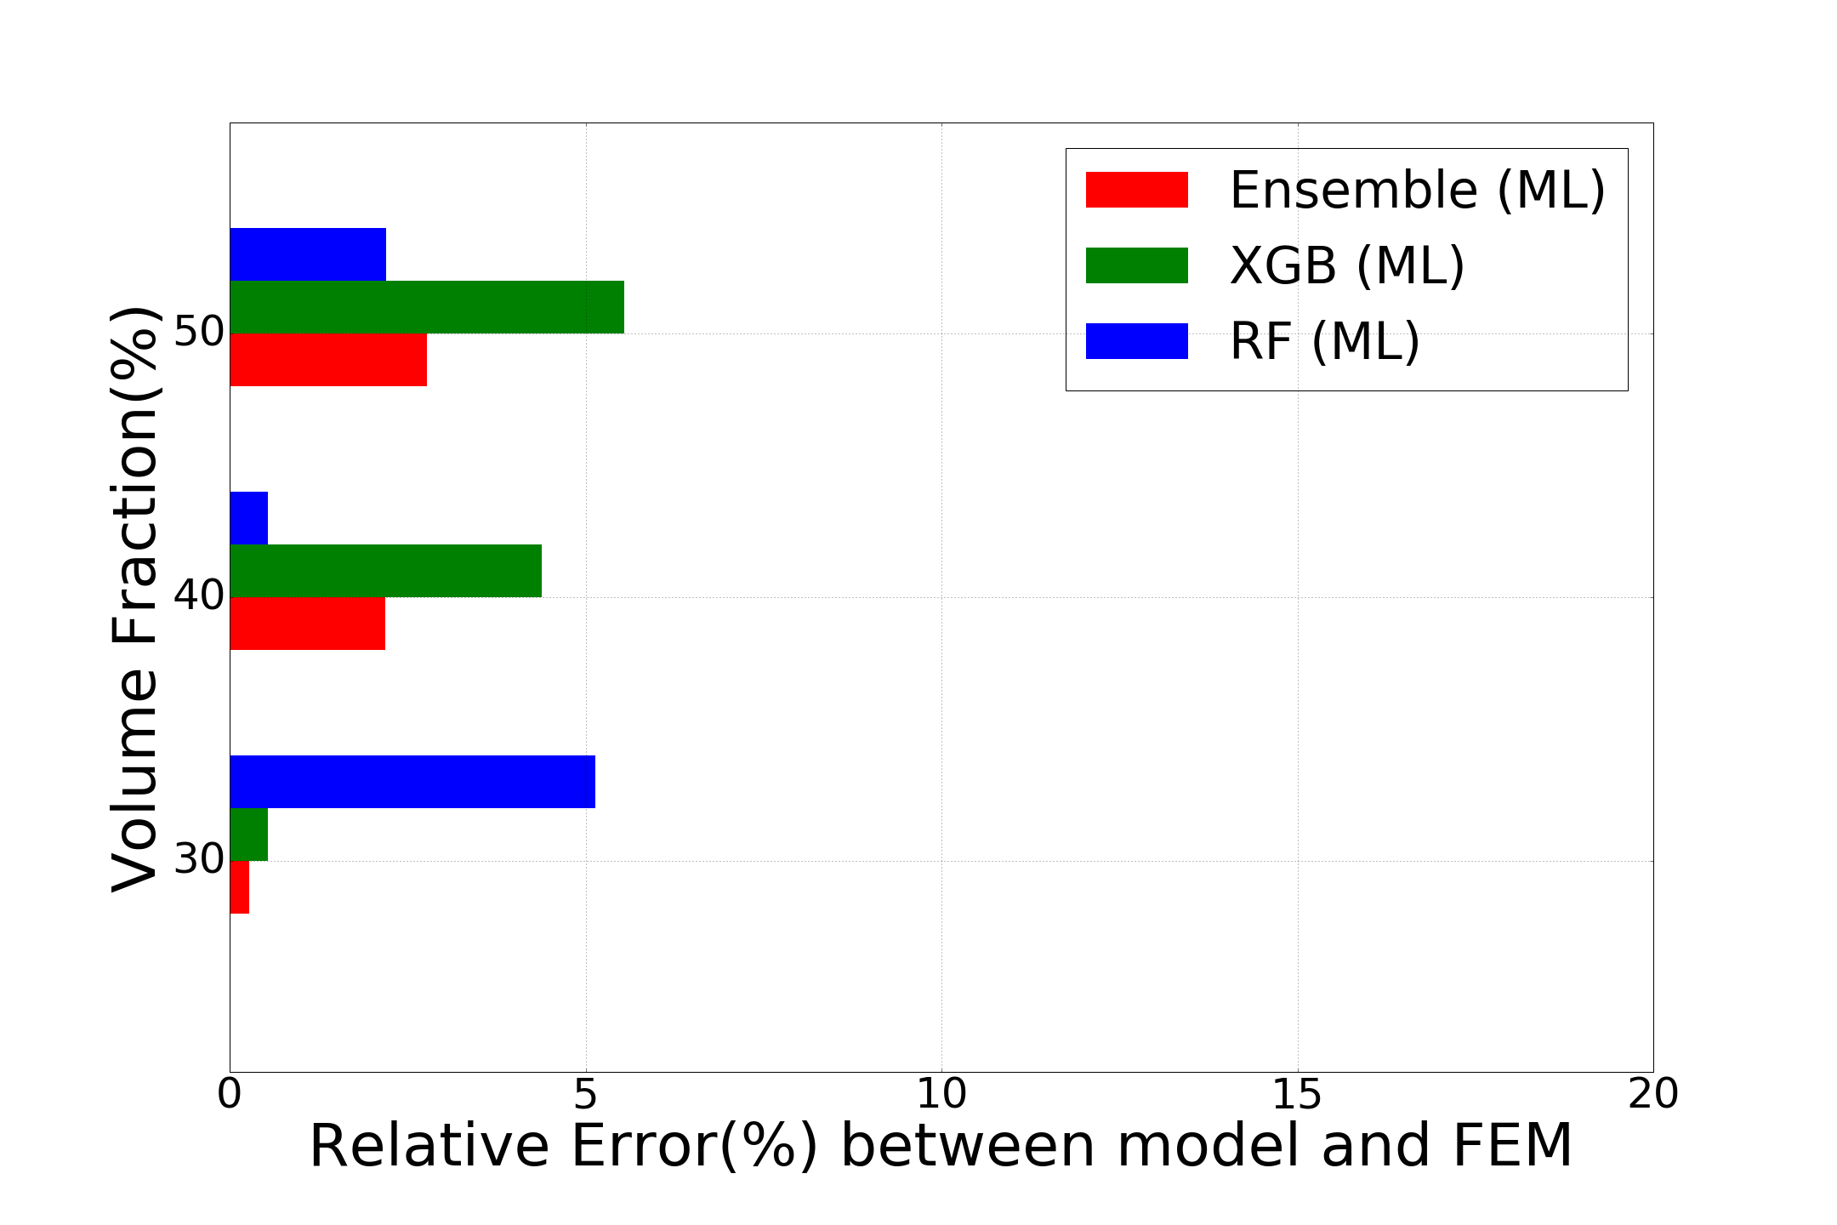
Percentage Error - Boron Epoxy (Young’s Modulus)

Slide 30
Conclusions: Findings of the Present Work
A data set comprising nearly 300 different types of materials, when fed to the Machine Learning model, is satisfactorily sufficient in predicting properties of virtually all materials in the range of the data.
Ensembles of several different Machine Learning models tend to perform better than more powerful single models in capturing trends in the data. Furthermore, it also helps in reducing overfitting and building a more robust model.
A Machine Learning approach for constructing the stress-strain curve of a new composite material gives promising results on different materials with different volume fractions, provided the strain is in the range of the data.

Slide 31
Conclusions: Future Scope
Variation in several other properties of materials like de-bonding of particles/fibres, ductility, and matrix failure (which can be used to calculate toughness and strength) can be introduced.
A more comprehensive database containing information on the manufacturing process of a material, shape, size, etc. can be constructed to enable this data to be used in industry.
Development of faster and automated techniques for generation of composite materials with high volume fractions.
The analysis can be extended to particles/fibres of different diameters.
The analysis can be extended to 3 dimensions with the introduction of particles. However, it would be significantly more computationally expensive.

Slide 32
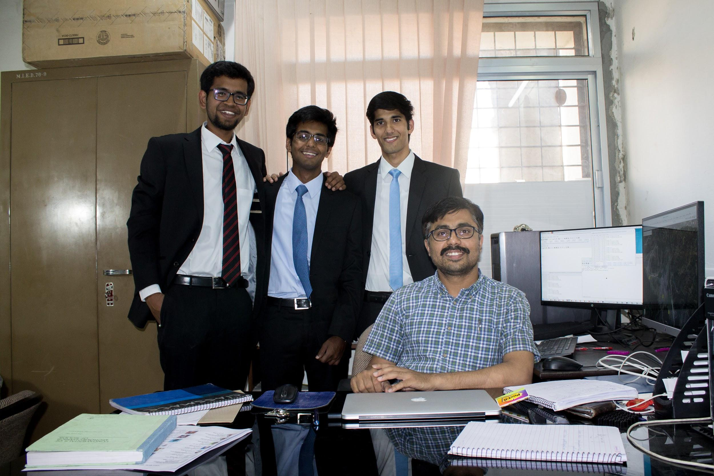
Thank You

